Slide 1


Slide 2
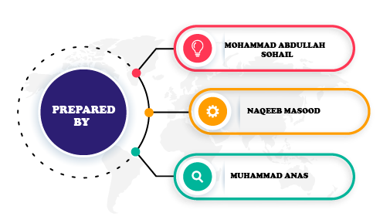

Slide 3


WHAT IS HOTEL MANAGEMENT SYSTEM?
The Hotel Management System aims to make simpler a staff’s interaction with the various modules of the Hotel and ease the process of acquiring information and providing services.. It will also allow cutting the operational costs of the hotel

Slide 4

OUR PROJECT
This hotel management system is developed for hotels those are using a manual system to handle hotel processes. Our project has Employee system that can store the details of staff and managers. It also has food serving system in which we can edit our order without canceling our previous order and Room Management System. The program cannot be executed without the authorized person’s Password. He can further change the password if he wants. The main aim of the entire activity is to automate the process of day to day activities of Hotel.

Slide 5

OUTLINE
--INTRODUCTION--
-PROJECTS OVERVIEW-
CLASSES:
Manager
Staff
Room
Bill

Slide 6

CONCLUSION
The Main Features of Hotel Management System (Project)
- Store the details of managers and staff
- Online food ordering system with additional option of canceling specific item from the order
- Room booking system with the option of updating details of room through Room number
- This project uses file handling to store the data of Employees in a project.

Slide 7

CLASSES IN INHERITED ORDER
ADMIN:
LOGIN()
MANAGER:
RECORD MANAGER()
INSERT MANAGER()
DISPLAY MANAGER()
UPDATE MANAGER()
DELETE MANAGER()

Slide 8

STAFF:
RECORD STAFF()
INSERT STAFF()
DISPLAY SATFF()
UPDATE STAFF()
DELETE STAFF()
ROOM:
INSERT ROOM()
DISPLAY ROOM()
UPDATE ROOM()
DELETE ROOM()

Slide 9


BILL:
INSERT BILL()
DISPLAY BILL()
DELETE BILL()
CONCLUSION
Hotel Management System is a project which aims in developing a computerized system to maintain all the daily work of a Hotel.
This project has many features which are generally not available in normal Hotel Management Systems like order editable function.
The system can be easily extended by introducing new classes

